Slide 1




FORECASTING SALES AND PERFORMANCE ANALYSIS

Slide 2
Introduction: Sales Forecasting
Any company that deals with tangible things needs to have effective sales forecasting. Sales forecasting is an inevitable process that each company must go through for financial stability, effective resource management, well-informed decision-making, and long-term corporate success.
It is important for several reasons:
Methodical Scheduling
Allocation of Resources
Financial planning and budgeting
Management of Production and Inventory
Strategies for Marketing and Sales
Risk Management Assessment of Performance

Slide 3
Steps Involved in Sales Forecasting
Data collection
Cleaning data and sorting it into the 4 categories
Adding the monthly sales for 3 months to get the sales of a quarter
calculating the deseasonalized sales

Slide 4
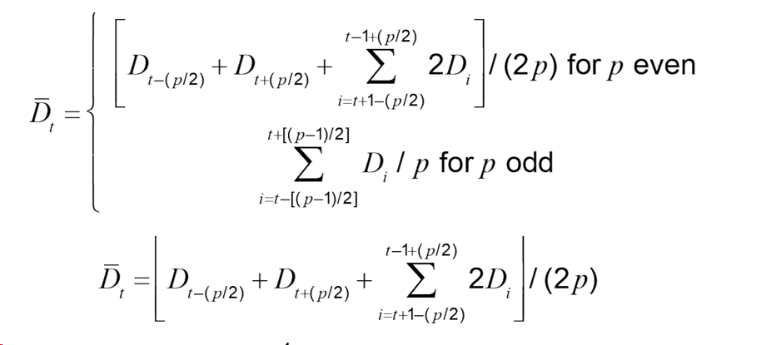
The formula used for calculating de-seasonalized demand

Slide 5
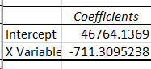
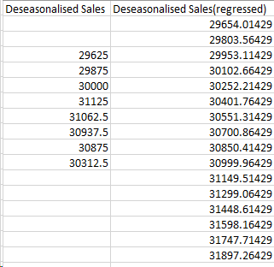
Further steps involved
Using the deseasonalized sales we regressed it against time (the period we are considering)
The regression result gives us the level and trend for the model
Using level and trend we found out the regressed seasonalized sales for each period

Slide 6
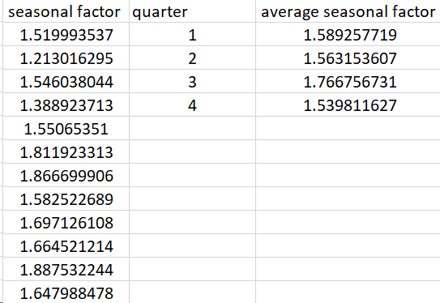
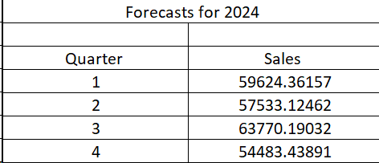
Getting the sales
Using our sales data and our obtained regressed deseasonalized sales values we found the seasonal factor for periods where our sales were known
We averaged seasonal factors for quarters by simply adding and dividing them by 3
Using the regressed deseasonalized and average seasonal factor for each quarter we predicted sales by simply multiplying the two numbers together.

Slide 7
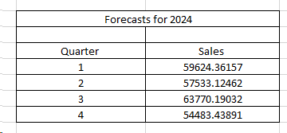
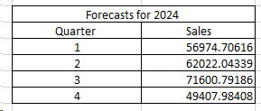


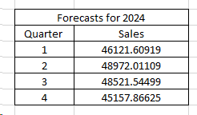
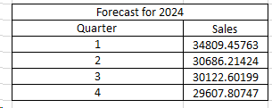

SALES
FORECASTS

Slide 8
The sales of cosmetics are expected to increase in the 3rd quarter of the year hence the company should be ready with the inventory in hand so that they are able to satisfy customer needs faster thereby increasing customer satisfaction and rising above their competitors.
01.
Inferences
4. Financial planning and budgeting for the 3rd quarter is very crucial in the growth of the company. As the sales rise management of production and inventory needs to be taken care of as well. To maximize profits there should be proper methodical scheduling of transport of goods.
5. As the sales decrease for any segment of products there is a huge risk of obsolete inventory and the large amount of costs associated with it. Therefore proper risk management and assessment of performance should be done at regular intervals of time.
There is expected to be a huge jump in the sales of footwear in the 3rd quarter as well, therefore the company should have that inventory ready as well to dish out orders as fast as they can and manage the sales of both the cosmetics and footwear together. And allocate their resources accordingly.
02.
The sales of both the bottom wear and topwear are expected to be pretty consistent. To increase the sales the company should employ proper marketing strategies for the respective segments.
03.

Slide 9
Performance Analysis
We have crunched some numbers to give you a clear picture of the company's overall performance.
Firm 1 - Nykaa (FSN E-Commerce Ventures)
Firm 2 - Zudio (Trent Limited)
Nykaa operates online with a few offline stores and sources its products from different manufacturers.
Zudio only operates offline stores, and all of its products are manufactured in-house.

Slide 10
Performance analysis
Similarly performance analysis gives businesses insightful information that promotes innovation, expansion, and continual improvement. Its importance can be attributed to the following reasons:
Identifying Strengths and Weaknesses
Optimizing efficiency
Staying Competitive
Improve customer satisfaction
enhancing Accountability
Monitoring progress
Making informed decisions
Setting goals and objectives

Slide 11
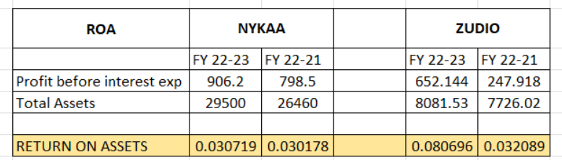
ROA measures the return on
every rupee invested in the firm.
Nykaa generated a lower return than the industry average.
While Zudio, in 21-22, generated sub-par returns, improved significantly in 22-23.
Return On Asset

Slide 12
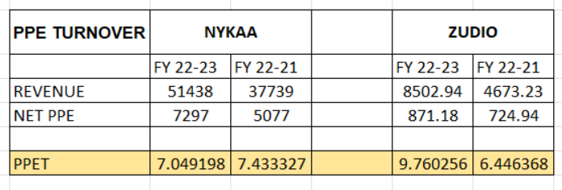
The PPE turnover ratio tells how efficient a firm is in converting its assets into revenue.
Nykaa saw a sudden dip as they started new warehouses recently.
While Zudio improved significantly due to there improved sales.
PPE Turnover

Slide 13
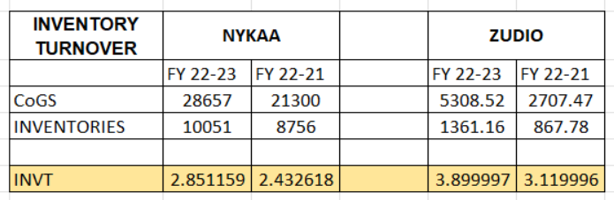
INVT shows how many times a company turned over its inventory relative to its CoGS.
Overstocking might be a reason for Nykaa’s lower INVT.
Zudio improved their INVT as they suffered stock-out issues in 21-22.
Inventory Turnover Ratio

Slide 14
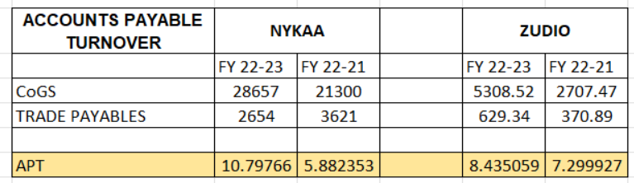
Accounts
Payables Turnover
It measures the rate at which the firm pays back to its suppliers.
Both firms improved their APT.

Slide 15
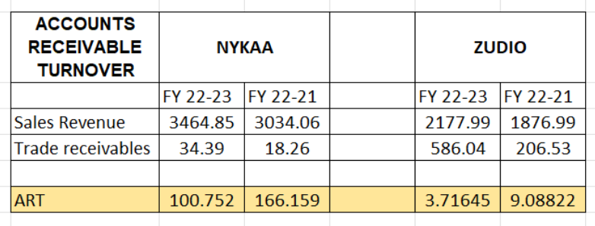
Accounts Receivables Turnover
ART tells the efficiency of a firm in collecting its receivables and managing its line of credit.
Nykaa has an exceptionally high ART; overhead costs may be a reason.
Zudio had a good ART for 21-22, but they had a spike in receivable in 22-23.

Slide 16
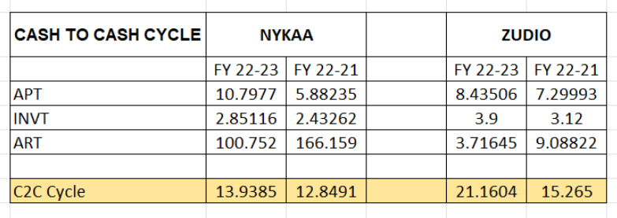
The C2C Cycle measures when cash enters and leaves.
Both Nykaa and Zudio observed a hike mainly due to receivables, but Zudio had a significant spike as their receivables increased by 3X.
Zudio manufactures its own products, which leads to higher C2C cycle.
Cash-To-Cash Cycle

Slide 17
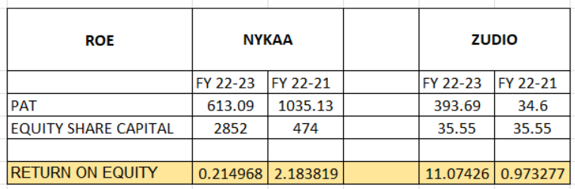
It is the main summary of
firm’s performance.
PAT decreased even after a
increase in revenue,
which shows Nykaa took
a significant amount of debt.
ROE, in this case, is not a good
criterion to compare.
Return On Equity

Slide 18
Presented by - Priyanshu Sethi and Kartik Sharma
Thank you very much!

